Slide 1
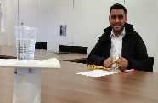
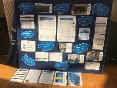
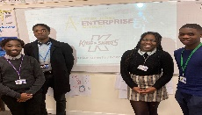
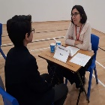
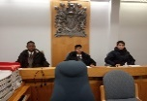
Careers and Enterprise at St Joseph’s College
University or apprenticeship
FINAL Exams
BTEC / A-Level
Practice your interview technique with UK Power Networks
Apply for University through UCAS
YEAR
13
Results Day!
Apprenticeship assembly and workshops
Careers meeting with Ms Cashmore
Work Experience
‘Ready for life beyond school’
Public speaking competitions
UCAS fair- my options after year 13
Enrichment clubs
University Visits
Results Day!
YEAR
12
Prepare for Post 16 courses next year…
START your A levels and BTECS
Peter Jones Academy
Industry Visits
Maths and finance workshops
How to set up your own business
Revision for
Summer EXAMS
‘Your future in your hands’
YEAR
11
Apprenticeship assembly
College Visits
Careers Interviews and action plans with Ms Cashmore
The Big Interview
College taster days
Peter Jones Tycoon
Exploring industries and working life
choosing my BTEC and GCSE subjects?
Understanding how to get into competitive Universities
University taster day
Developing Character:
What are my strengths and values
YEAR
GCSE and BTEC courses begin
10
Leadership
Opportunity Public Speaking
Mock Trial: aspiring Lawyers compete
Focus on
Linking my subjects to careers
Leadership skills at student council
My options after year 11
Aiming high, achieving goals
University of Sussex Visit: University life and subjects tasters
Science Careers workshop- Pandemics
Peter Jones Tycoon Enterprise Challenge
Financial awareness
Building Character:
Core Values
YEAR
9
Peter Jones Flash Challenge
University of Sussex inspiring assembly
APPLY to become House Captain
Duke of Edinburgh award
Science careers workshop: CSI
Expectations in the workplace and how to get a job!
Character lessons!
Stem careers workshop
Work experience in the school office
YEAR
8
leadership
Communication
Resilience
Initiative
YEAR
Linking subjects to the world of work
7
Skills for a successful life: Communication, resilience and teamwork
Our visitors include:
PRIMARY
Summer school
@careersat_sjc
Skills• Experiences • Qualifications: Career

